Slide 1

Room G
Start: 10:30
15:18
Async Streams Stephen Cleary

Slide 2


Slide 3

Who is this guy?

Slide 4
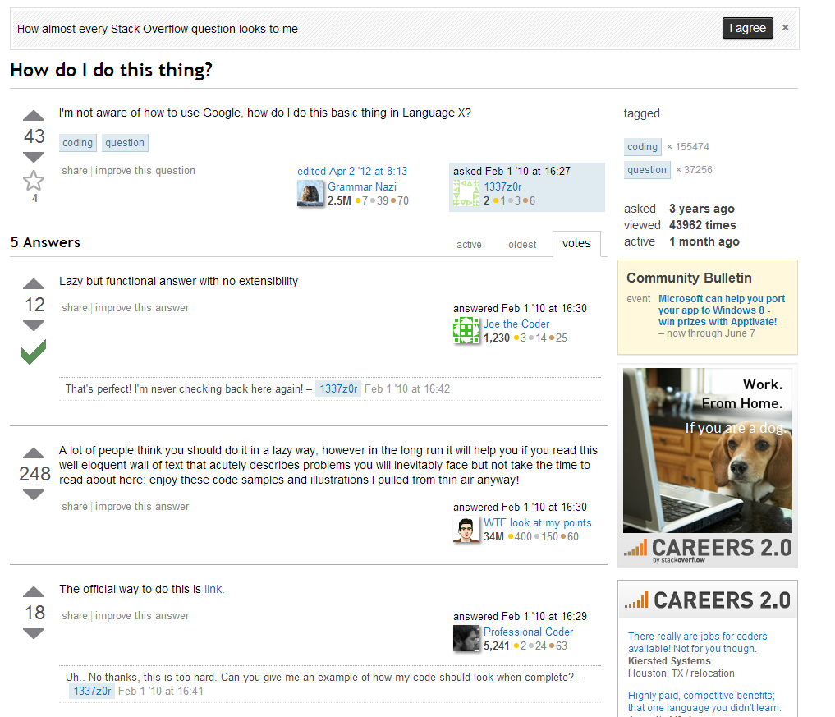
Notes:
I’m the “async guy” on Stack Overflow.
Not Jon Skeet.
Also have a blog (mostly async these days).
Regular developer, not a travel-the-world elite speaker.

Slide 5

Notes:
Don’t buy this book. The 2nd edition is coming out shortly.

Slide 6
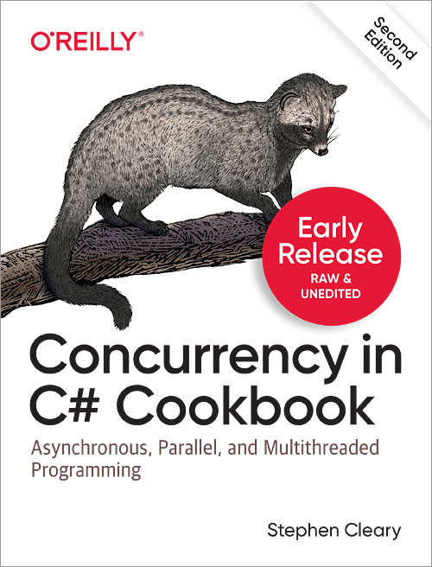
Notes:
Don’t buy this book. The 2nd edition is coming out shortly.

Slide 7
The Async Invasion
A Brief History

Slide 8
Async Invasion Timeline
Async/await (Futures):
2012: C# 5.0
2015: TypeScript 1.6
2015: Python 3.5
2017: JavaScript ES2017
Async streams (async generators):
2016: Python 3.6
2017: TypeScript 2.3
2018: JavaScript ES2018
2019: C# 8.0 (.NET Core 3.0 only, currently in preview)
Notes:
This talk is focused mainly on the C# version, because the others are very straightforward.

Slide 9
Async Streams in One Sentence:
You can use await and yield return in the same method.

Slide 10


Slide 11
Async Streams: More Detail
Enumerators/Generators/Iterables:
“Deferred execution” – generated on demand
Pull-based sequence. E.g., foreach.
Async streams:
Still deferred execution. Still pull-based.
“Get Next Item” is asynchronous.
MoveNext, MoveNextAsync (C#) / next (JS) / __next__, __anext__ (Python)
Allows asynchronous enumerators/generators/iterables.
Requires asynchronous consumers.
Notes:
Deferred: Re# will give you a warning if you re-evaluate an enumerator, because it re-generates the values.
“Get Next Item” – for the most part, just an implementation detail, but you may see these in stack traces.

Slide 12
Why Async Streams?

Slide 13
Why Async?
Real-world benefits from asynchrony
Client | Server
Primary benefit: Responsiveness | Primary benefit: Scalability
Keep UI thread free | Minimize threads used to serve requests
Better UX | 10x-100x scalability (same box)
Required by many app stores | Faster response to bursting traffic
Notes:
The benefits for client and server are different, but both come from the same core: freeing up threads. (Not using more threads).

Slide 14
Why Async Streams?
From three perspectives:
Enumerables
Tasks
Observables

Slide 15
Why Async Streams? (vs Enumerable)
What we have: Enumerable
Enumerables are synchronous.
Tasks/async/await are also available, and are asynchronous.
What we want:
We want to do asynchronous work during enumeration.

Slide 16
Why Async Streams? (vs Task)
What we have: Task
Tasks only produce a result once.
Enumerables can generate multiple results.
What we want:
We want to generate multiple results asynchronously.

Slide 17
Why Async Streams? (vs Observable)
What we have: Observable
Asynchronous and multi-valued.
What we want:
More natural consumption. E.g., foreach or async subscriptions.
Lower training bar.
Enumerables and tasks have natural consumption.
“Natural consumption” is code for “pull-based”.
Notes:
This perspective is less common because observables are not widely adopted in C#.
(They are in JS, because the threading model is simpler)

Slide 18
Why Async Streams?
Summary of three different perspectives:
Compared to… | which is… | IAsyncEnumerable<T> is…
IEnumerable<T> | synchronous | asynchronous
Task<T> | single value | multiple values
IObservable<T> | push-based | pull-based

Slide 19
How Async Streams Fit In
Desired Access | Return Type
Single value, synchronous | T
Multiple values, synchronous | IEnumerable<T>
Single value, asynchronous (pull) | Task<T>
Single value, asynchronous (push) | IObservable<T>
Multiple values, asynchronous (pull) | IAsyncEnumerable<T>
Multiple values, asynchronous (push) | IObservable<T>
Notes:
Async streams complement existing Future/observable approaches; they do not replace them.

Slide 20
Creating Async Streams

Slide 21
Creating Async Streams
C#:
Return type is IAsyncEnumerable<T>
Use await and yield return in an async method.
Javascript:
Use await and yield in an async function* function.
Python:
Use await and yield in an async method.

Slide 22
Async + Yield Return Sorta-Demo
We end up with both: Deferred execution and asynchronous pausing.

Slide 23
Async Streams: The Async Part

Slide 24
Where the Asynchrony Is (C#)
“Get Next Item” (as used by foreach) is asynchronous:
IEnumerator<out T>
: IDisposable
{
T Current { get; }
bool MoveNext();
}
IAsyncEnumerator<out T>
: IAsyncDisposable
{
T Current { get; }
ValueTask<bool> MoveNextAsync();
}

Slide 25
foreach
foreach (var i in s)
{
Console.WriteLine(i);
}
using (var e = s.GetEnumerator())
{
while (e.MoveNext())
{
var i = e.Current;
Console.WriteLine(i);
}
}

Slide 26
await foreach
await foreach (var i in s)
{
Console.WriteLine(i);
}
await using (var e = s.GetAsyncEnumerator())
{
while (await e.MoveNextAsync())
{
var i = e.Current;
Console.WriteLine(i);
}
}

Slide 27
ValueTask (C#)
ValueTask<T> is a more efficient Task<T>
Particularly if the result is commonly synchronous.
Usage restriction: Only consume once!
“Consume” means await or AsTask
Other properties may behave differently than Task<T>
Result is invalid until the value task has completed.
Same for GetAwaiter().GetResult()
Notes:
C#-specific
You don’t need to know this unless you’re consuming ValueTasks directly; the compiler-generated code for consuming async streams will always do the right thing.

Slide 28
Consuming Async Streams

Slide 29
Basic Usage
C#:
Use await foreach in an async method.
JavaScript:
Use foreach await in an async function.
Python:
Use async for in an async method.
A word on exceptions

Slide 30
Demo: Consuming Async Streams
await foreach supports ConfigureAwait(false)

Slide 31
Async Streams Use Case
Notes:
Making this more realistic.

Slide 32
Use Case: Paging API
Demo

Slide 33
Anti-Use Case: Notification API
E.g.:
SignalR
Semi-HTTP multi-response streams (stock quotes)
Anything with a subscribe + multiple updates + unsubscribe system is a better fit for observables.
Notes:
SignalR: connect to hub + get multiple messages + disconnect from hub
Stock quote APIs: connect to socket + get multiple messages + disconnect socket
Because they’re naturally push-based.

Slide 34
LINQ to Async Streams
Notes:
LINQ-to-objects, LINQ-to-events, LINQ-to-streams.
This whole section is C#-only. Python has similar support in iter-tools.

Slide 35
Basic LINQ
NuGet: System.Linq.Async
Community project, not Microsoft-supported.
All the standard operators:
Where, Select, SelectMany, Join, etc.

Slide 36
Async Lambdas in LINQ
LINQ-to-Streams has overloads for async lambdas:
WhereAwait, etc.
Await suffix, since they await their delegates.
Return IAsyncEnumerable<T> so they chain naturally.

Slide 37
Awaiting Results in LINQ
“Terminal” operators end in Async since they return awaitables
CountAsync, etc.
Terminal operators also have overloads for async lambdas:
CountAwaitAsync
Notes:
Naming is subject to change.

Slide 38
Supercharging Regular LINQ
When you have an ordinary LINQ expression,
and you want to use an async lambda (e.g., for Where)
Your solution: ToAsyncEnumerable
Then you can use WhereAwait, etc.
(This does “lift” to an IAsyncEnumerable<T>).

Slide 39
LINQ to Streams
Demo

Slide 40
Cancelling Async Streams
Notes:
This whole section is C#-only.

Slide 41
Responding to Cancellation
Take a CancellationToken.
Apply the EnumeratorCancellation attribute.
This is new.

Slide 42
Requesting Cancellation (easy)
The simple way:
Pass CancellationToken to the method returning an enumerable.
The complex way:
Use WithCancellation when enumerating.
Because enumerators are cancellable, not enumerables.

Slide 43
Async Streams & Cancellation
Demo

Slide 44

Q&A
Go forth and be awesome!
Image from Etsy user Rosewine; used with permission
Notes:
Slides are available at StephenCleary.com

